Slide 1
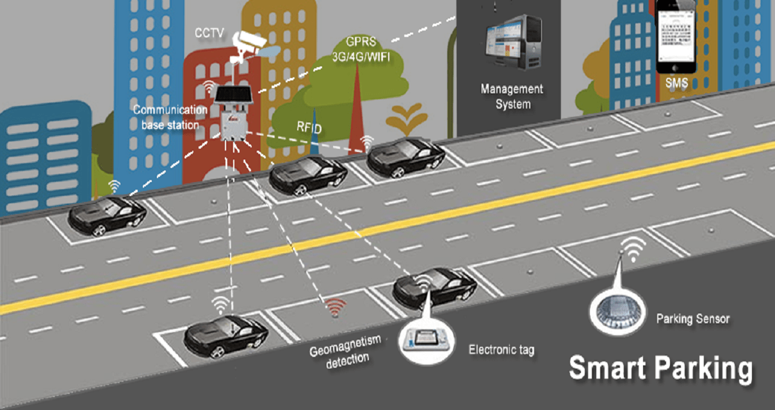
Problem Description:
The city of Orlando has a downtown parking problem. Motorists find it hard to find parking even though there are many metered parking street spots in and around the downtown area.
The problem is worse during the peak demand hours of weekday mornings and weekend evenings.
The free parking spots are not always easy to locate.
This leads to a number of motorists roaming around looking for parking which makes the problem worse by creating additional traffic congestion.

Slide 2














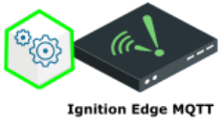









On Premise
AWS Cloud
Enterprise
AWS
Data Ingest & Storage
Warehouse & Analytics
Users
MQTT &
Deployment
Kinesis
Firehose
AWS S3
Raw Data
AWS Glue
Transform
AWS S3
Processed/
Normalized Data
ElasticSearch
AWS Greengrass
Historian
RedShift
AWS IoT Core
MQTT Topics
IoT Rules
Tablets
Kinesis
Data Analytics
Kinesis
Data Streams
Kinesis
Firehose
Ignition
Gateway
SageMaker
Data Processing
Data Visualization
Edge Devices
RDS DynamoDB
AWS S3
NodeJS/React
Front End App
QuckSight
Charts/Dashboard
Computer Browser
AWS Lambda
Web Sockets
API Gateway
Web Sockets
Config/Master data
Config/Master data/Notification/Routing
Notifications
AWS Common services
API IAM
CloudWatch
CloudTrail
CloudFront
DynamoDB
Route 53
Code Pipeline
AWS S3
AWS SNS
Notes:
Future Scope:
As of now we are going with DynamoDB for time series data storage, but in future we can use AWS Timestream which is currently in Beta version and AWS claiming it will be much faster and robust than DynamoDB.
At edge we mentioned Historian DB, which can be referenced from existing solution or can be browsed other solutions like,
InfluxDB, TimescaleDB, OpenTSDB and few more,…
Flexible Computing & Storage if required at Edge side, best option can be AWS Snowball Edge.

Slide 3


On Premise Edge
Smart Parking AWS IoT Architecture (Simplified for current development)
sp_device_registration
IoT Rules
AWS Lambda
AWS RDS
AWS_PARKING_DEVICE_MASTER
MQTT over SSL
MQTT &
Deployment
sp_device_death
AWS Greengrass
AWS Lambda APIs
NodeJS programs
For Parking locations,
Status updates, Alerts
AWS IoT Core
IoT Rules
Historian
AWS RDS
AWS_PARKING_DEVICE_STATUS
sp_device_status
Option 1
Ignition
Gateway
Local PC/
EC2 Win
Option 2
Python Scripts
(Device Simulations)
registration.py
death.py
parkingStatus.py
camera.py
userParking.py
WebSockets
HTTP
IoT Rules
AWS Lambda
sp_device_status
API Gateway APIs
Endpoints
For Parking locations,
Status updates, Alerts
MySQL with Device
Inventory Details for
In Memory Sensor Tags
IoT Events
DynamoDB
AWS_PARKING_ALERTS_WARNINGS
IoT Rules
AWS Common services
API IAM
CloudWatch
AWS SNS
AWS S3
Code Pipeline
Cloud Formation

